Slide 1
Chapter 3: Point-to-Point Connections
Connecting Networks
Notes:
Cisco Networking Academy program
Connecting Networks
Chapter 3: Point-to-Point Connections

Slide 2
Chapter 3
3.1 Serial Point-to-Point Overview
3.2 PPP Operation
3.3 Configuring PPP
3.4 Troubleshooting WAN Connectivity
3.5 Summary
Notes:
Chapter 5

Slide 3
3.1 Serial Point-to-Point Overview
Notes:
3.1 Serial Point-to-Point Overview

Slide 4
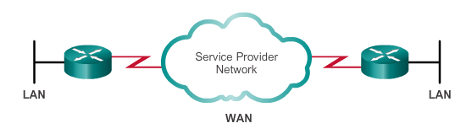
Serial and Parallel Ports
Point-to-point connections are used to connect LANs to service provider WANs.
Also referred to as a serial connection or leased-line connection.
Serial connection in which the bits are transmitted sequentially over a single channel, bidirectional
In parallel communications, bits can be transmitted simultaneously over multiple wires, one way
Notes:
3.1.1.1 Serial and Parallel Ports

Slide 5
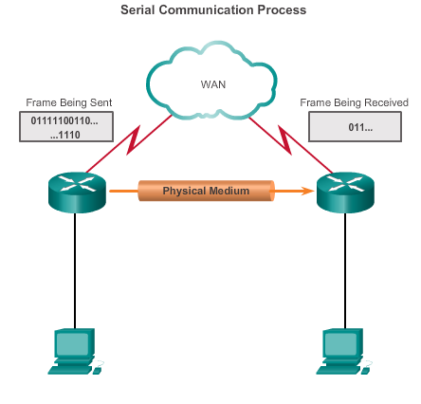
Serial Communications Serial Communication
On the WAN link, data is encapsulated by the protocol used by the sending router.
Encapsulated frame is sent on a physical medium to the WAN.
Receiving router uses the same communications protocol to de-encapsulate the frame when it arrives.
Three serial communication standards for LAN-to-WAN connections: RS-232, V.35, HSSI
Notes:
3.1.1.2 Serial Communication

Slide 6
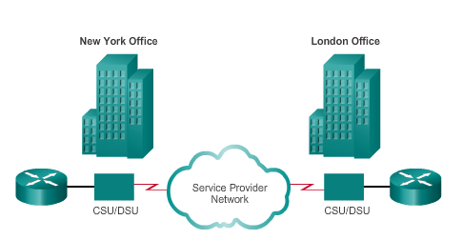
Serial Communications Point-to-Point Communication Links
Point-to-point links can connect two geographically distant sites.
Carrier dedicates specific resources for a line leased by the customer (leased-line).
Point-to-point links are usually more expensive than shared services.
Notes:
3.1.1.3 Point-to-Point Communication Links

Slide 7
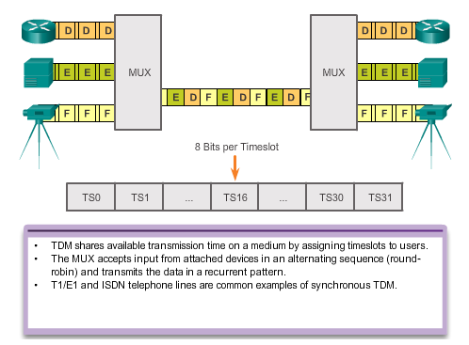
Serial Communications Time-Division Multiplexing
Multiplexing – A scheme that allows multiple logical signals to share a single physical channel.
Notes:
3.1.1.4 Time-Division Multiplexing

Slide 8
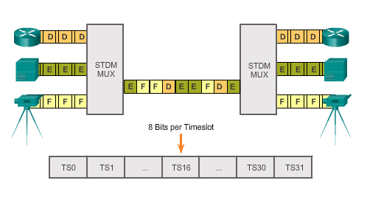
Serial Communications Statistical Time-Division Multiplexing
STDM uses a variable time-slot length, allowing channels to compete for any free slot space.
STDM does not waste high-speed line time with inactive channels using this scheme.
Notes:
3.1.1.5 Statistical Time-Division Multiplexing

Slide 9
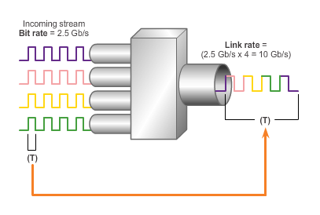
Serial Communications TDM Examples
The industry uses the Synchronous Optical Networking (SONET) or Synchronous Digital Hierarchy (SDH) standard for optical transport of TDM data.
Traffic arriving at the SONET multiplexer from four places at 2.5 Gb/s goes out as a single stream at 4 x 2.5 Gb/s or 10 Gb/s.
Example: TDM SONET
Notes:
3.1.1.6 TDM Examples

Slide 10
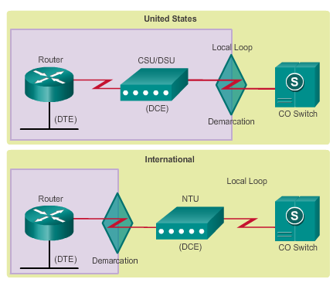
Serial Communications Demarcation Point
Marks the point where your network interfaces with a network that is owned by another organization
Interface between CPE and network service provider equipment
Point in the network where the responsibility of the service provider ends
Notes:
3.1.1.7 Demarcation Point

Slide 11
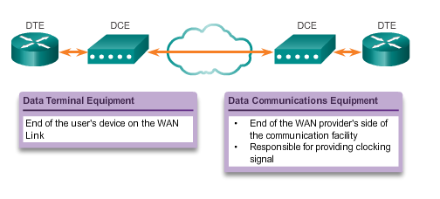
Serial Communications DTE-DCE
DTE – Commonly CPE, generally a router, could also be a terminal, computer, printer, or fax machine if they connect directly to the service provider network.
DCE – Commonly a modem or CSU/DSU, it is a device used to convert the user data from the DTE into a form acceptable to the WAN service provider transmission link. The signal is received at the remote DCE, which decodes the signal back into a sequence of bits; the remote DCE then signals this sequence to the remote DTE.
Notes:
3.1.1.8 DTE-DCE

Slide 12
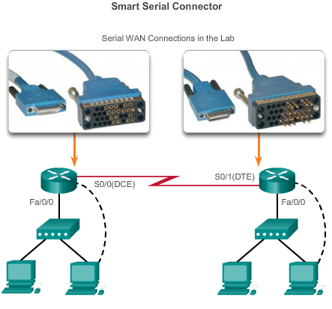
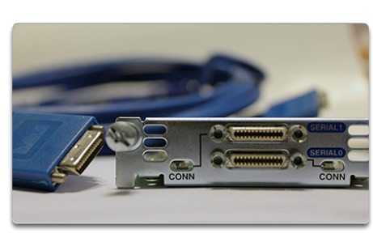
Serial Communications Serial Cables
Notes:
3.1.1.9 Serial Cables

Slide 13
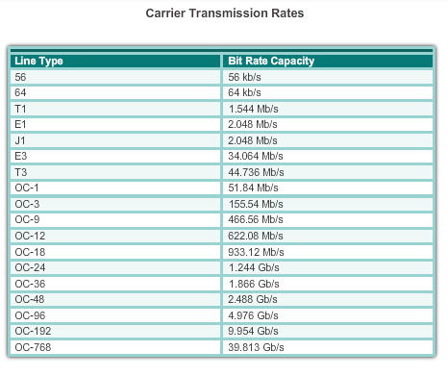
Serial Communications Serial Bandwidth
Bandwidth refers to the rate at which data is transferred over the communication link.
Notes:
3.1.1.10 Serial Bandwidth

Slide 14
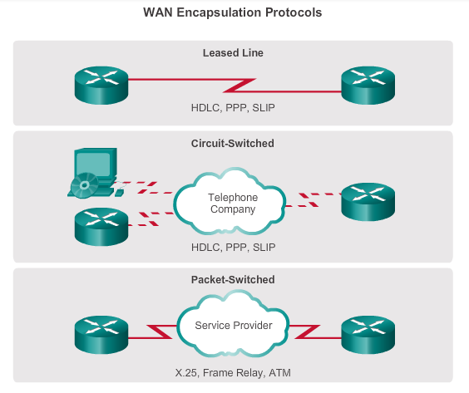
HDLC Encapsulation WAN Encapsulation Protocols
Data is encapsulated into frames before crossing the WAN link; an appropriate Layer 2 encapsulation type must be configured.
Notes:
3.1.2.1 WAN Encapsulation Protocols

Slide 15
HDLC Encapsulation HDLC Encapsulation
Bit-oriented, synchronous data link layer protocol developed by the International Organization for Standardization (ISO).
Uses synchronous serial transmission to provide error-free communication between two points.
Defines a Layer 2 framing structure that allows for flow control and error control through the use of acknowledgments.
Cisco has developed an extension to the HLDC protocol to solve the inability to provide multiprotocol support (Cisco HLDC also referred to as cHDLC).
Notes:
3.1.2.2 HDLC Encapsulation

Slide 16
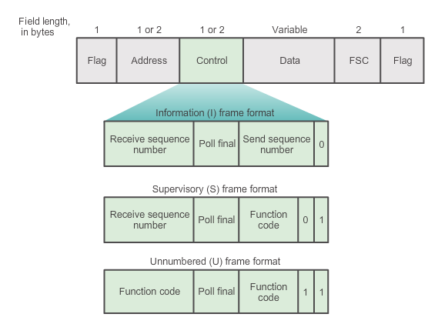
HDLC Encapsulation HDLC Frame Types
The Flag field initiates and terminates error checking, and the frame always starts and ends with an 8-bit flag field, 01111110.
I-frames carry upper layer information and some control information; sends and receives sequence numbers, and the poll final (P/F) bit performs flow and error control.
S-frames provide control information – Request and suspend transmission, report on status, and acknowledge receipt of I-frame.
U-frames support control purposes and are not sequenced.
Notes:
3.1.2.3 HDLC Frame Types

Slide 17

HDLC Encapsulation Configuring HDLC Encapsulation
Default encapsulation method used by Cisco devices on synchronous serial lines
Point-to-point protocol on leased lines between two Cisco devices
Connecting to a non-Cisco device, use synchronous PPP
Notes:
3.1.2.4 Configuring HDLC Encapsulation

Slide 18
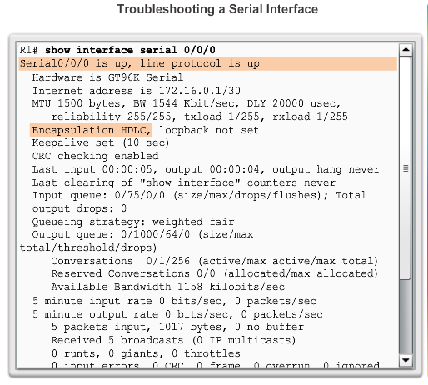
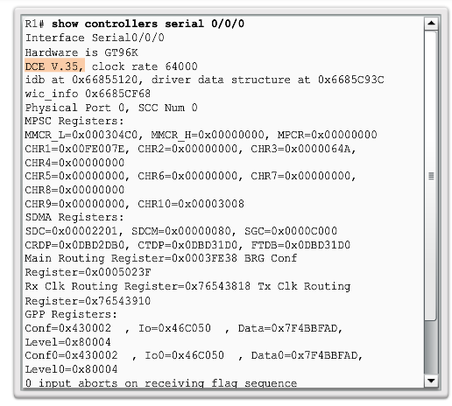
HDLC Encapsulation Troubleshooting a Serial Interface
Notes:
3.1.2.5 Troubleshooting a Serial Interface

Slide 19

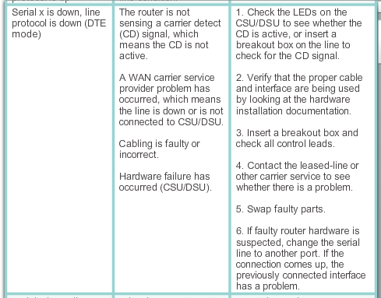
HDLC Encapsulation Troubleshooting a Serial Interface (cont.)
Notes:
3.1.2.5 Troubleshooting a Serial Interface

Slide 20

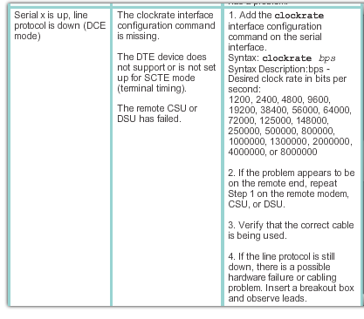
HDLC Encapsulation Troubleshooting a Serial Interface (cont.)
Notes:
3.1.2.5 Troubleshooting a Serial Interface

Slide 21
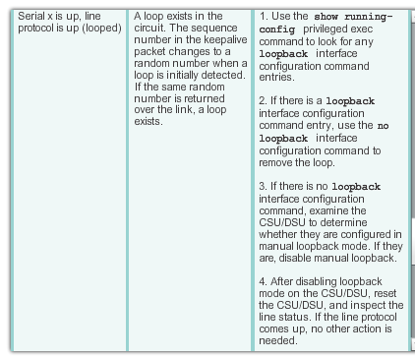

HDLC Encapsulation Troubleshooting a Serial Interface (cont.)
Notes:
3.1.2.5 Troubleshooting a Serial Interface

Slide 22
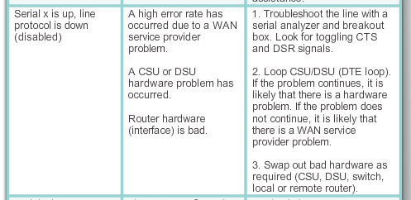
HDLC Encapsulation Troubleshooting a Serial Interface (cont.)
Notes:
3.1.2.5 Troubleshooting a Serial Interface

Slide 23
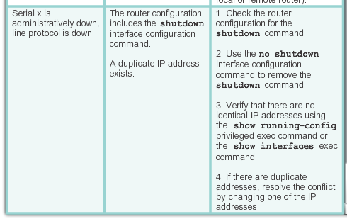
HDLC Encapsulation Troubleshooting a Serial Interface (cont.)
Notes:
3.1.2.5 Troubleshooting a Serial Interface

